Slide 1

Seasons of Code: (Un)Clear
Explanation by EKNOOR SINGH
Roll Number: 200020051

Slide 2
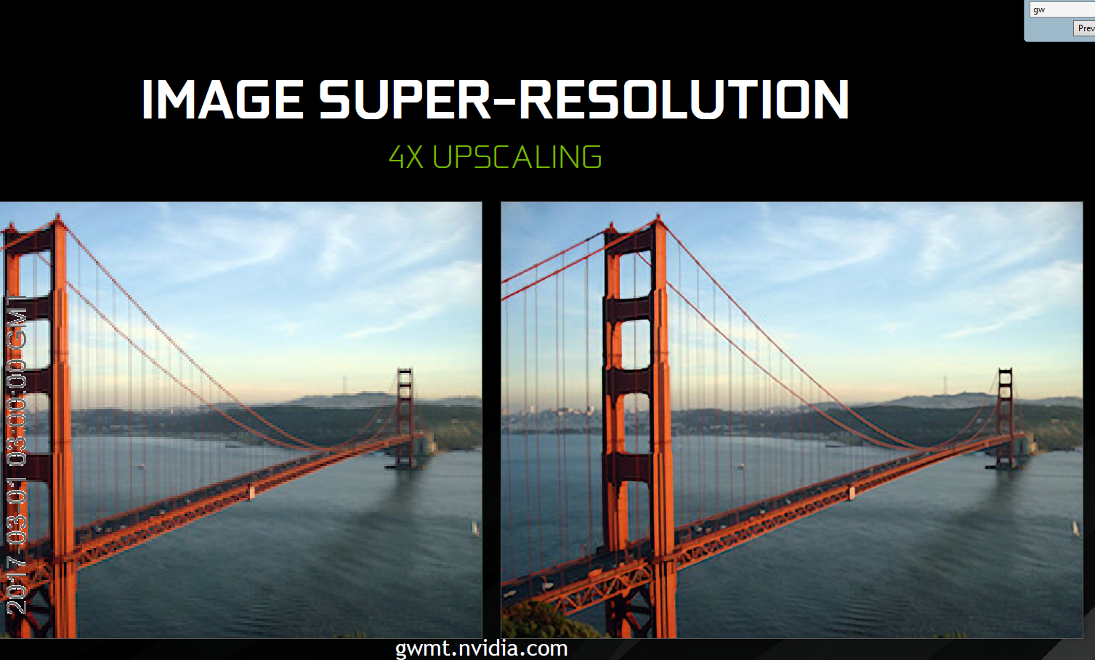
Super Resolution: Meaning and Applications
Image super-resolution (SR) techniques reconstruct a higher-resolution image or sequence from the observed lower-resolution images. Often a low-resolution image is taken as an input and the same image is upscaled to a higher resolution, which is the output. The details in the high-resolution output are filled in where the details are essentially unknown.
Super resolution is essentially what you see in films and series like CSI where someone zooms into an image and it improves in quality and the details just appear.
There are many applications of super-resolution, it is used successfully for improving medical imaging systems, satellite imaging, in surveillance, astronomical imaging; new ideas are emerging all the time. Many Companies like Disney, Nvidia use this technique to increase the quality of Videos.

Slide 3
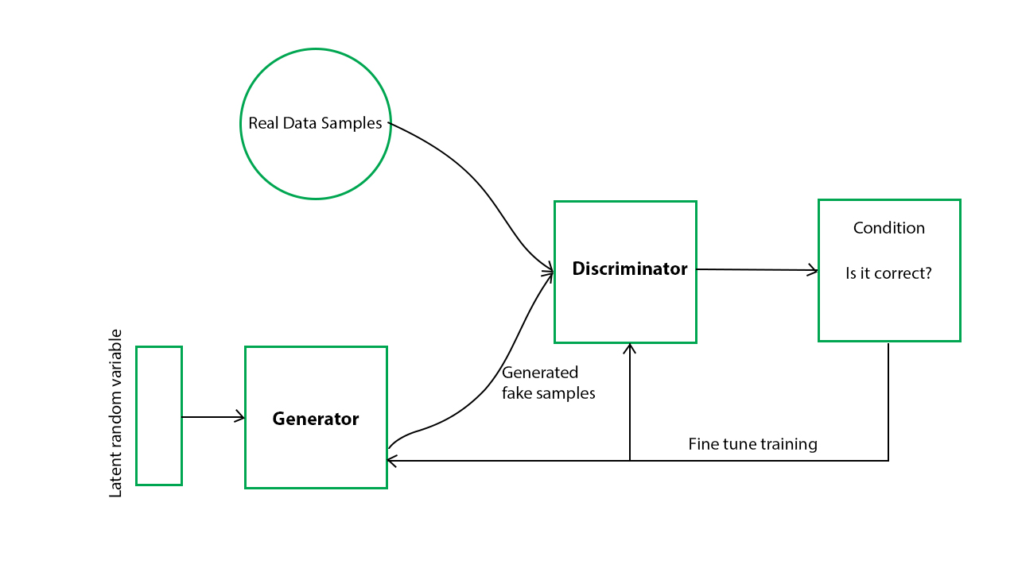
How We Achieved it in This Project?
The traditional methods using interpolation causes blurriness in the image
We thus focused on deep Learning methods. The solution we proposed includes usage of Generative Adversarial Networks (simply GANs) as a framework to tackle this problem

Slide 4


Slide 5
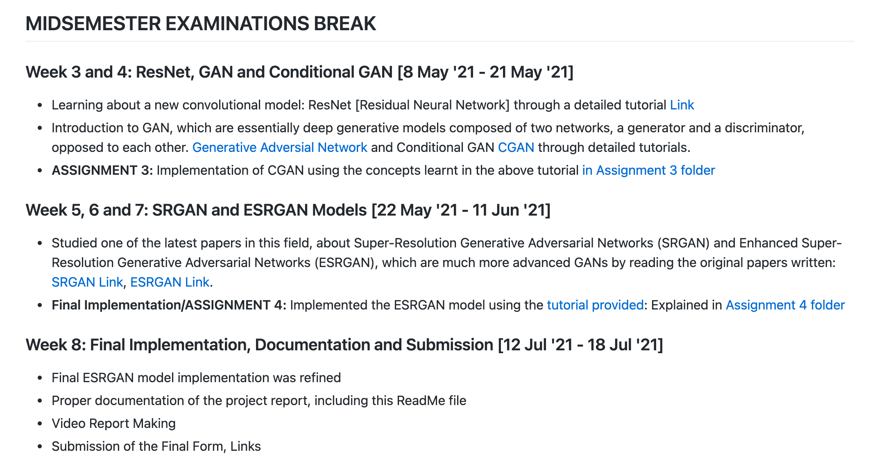

Slide 6

New Concepts Learnt
Neural Networks: Neural networks, also known as artificial neural networks (ANNs) or simulated neural networks (SNNs), are a subset of machine learning and are at the heart of deep learning algorithms
Convolutional Neural Networks: A convolutional neural network (CNN) is a type of artificial neural network used in image recognition and processing that is specifically designed to process pixel data
TensorFlow: TensorFlow is a free and open-source software library for machine learning. It can be used across a range of tasks but has a particular focus on training and inference of deep neural networks.

Slide 7
New Concepts Learnt
GAN Generative Adversial Networks: Generative modeling is an unsupervised learning task in machine learning that involves automatically discovering and learning the regularities or patterns in input data in such a way that the model can be used to generate or output new examples that plausibly could have been drawn from the original dataset.
SRGAN: SRGAN is a generative adversarial network for single image super-resolution.
ESRGAN: ESRGAN is the enhanced version of the SRGAN. Authors of the ESRGAN tried to enhance the SRGAN by modifying the model architecture and loss functions.

Slide 8
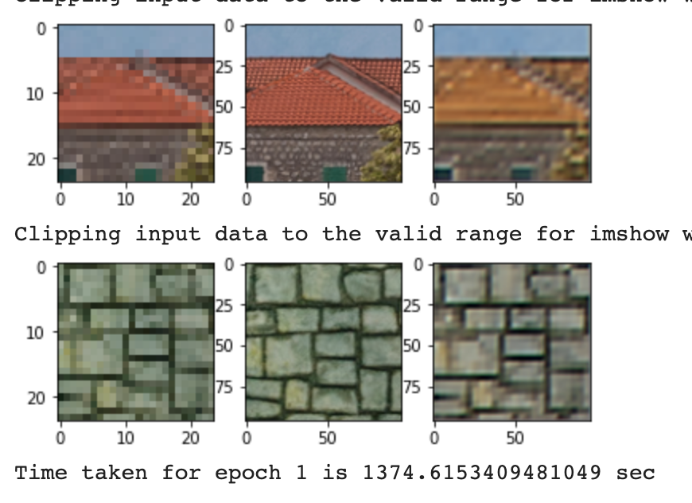
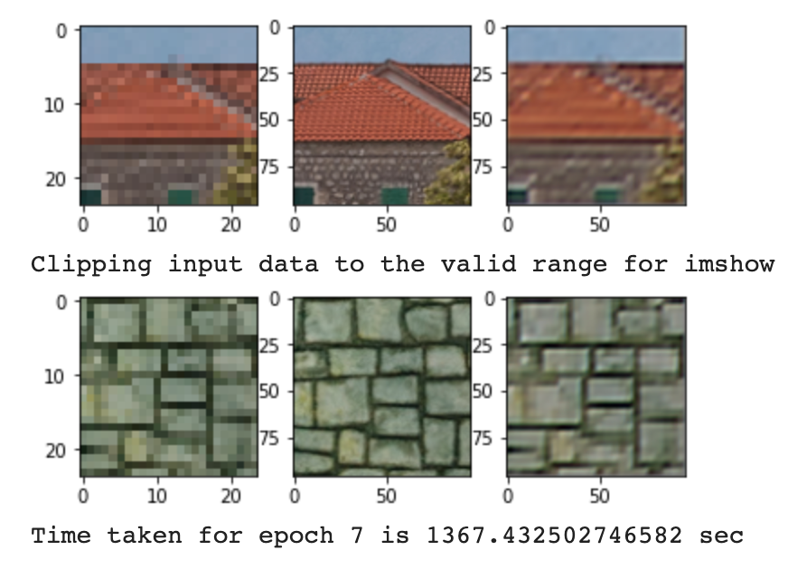
Final Output Examples of My Model
After First Epoch
After Seventh Epoch

